Slide 1
Python Calculator
Sweety Masmiya

Slide 2
Module
Using the Tkinter module, which is Python’s standard GUI library, we can create graphical user interfaces. It provides a graphical interface for users to select colors and also includes utilities for managing font styles and properties.

Slide 3
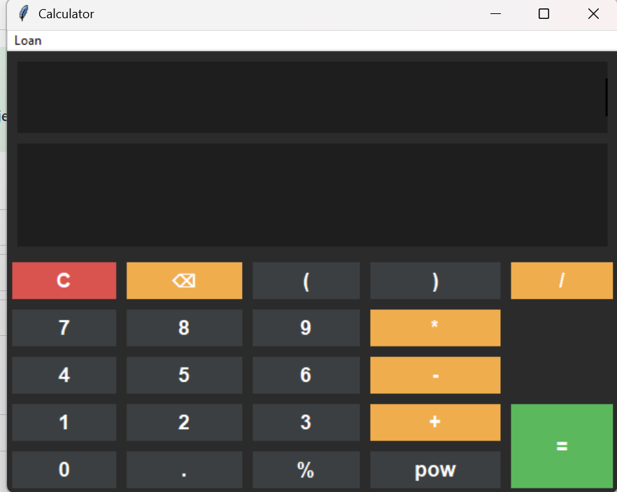
This project is a user-friendly calculator
application designed with a modern
dark-themed interface. It performs basic
arithmetic operations such as addition,
subtraction, multiplication, and division,
along with advanced functions like
percentage and power calculations.
The interface includes clearly arranged buttons
for numbers (0–9), operators, and special
functions like clear (C), delete (backspace),
and brackets for complex expressions.
A dual display panel allows users to view both
the current input and the calculated result.

Slide 4
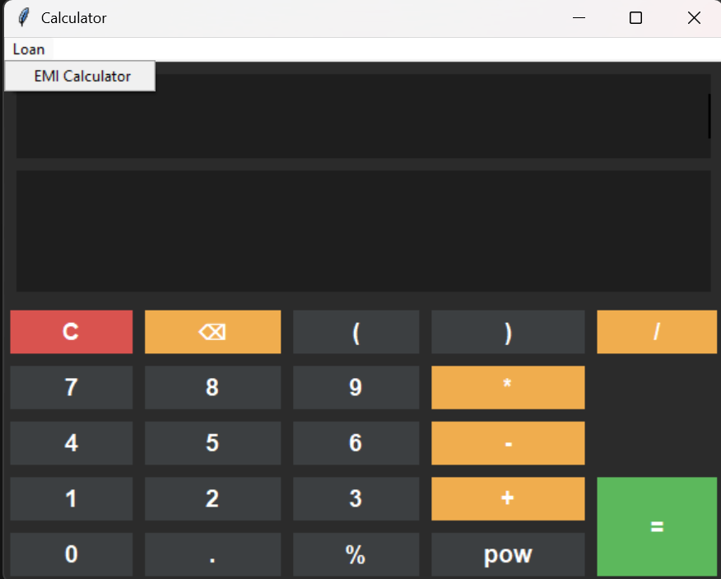
The Loan menu provides an EMI Calculator
feature. When the user selects this option, a
new screen is displayed, allowing the user to
calculate the Equated Monthly Installment (EMI).

Slide 5
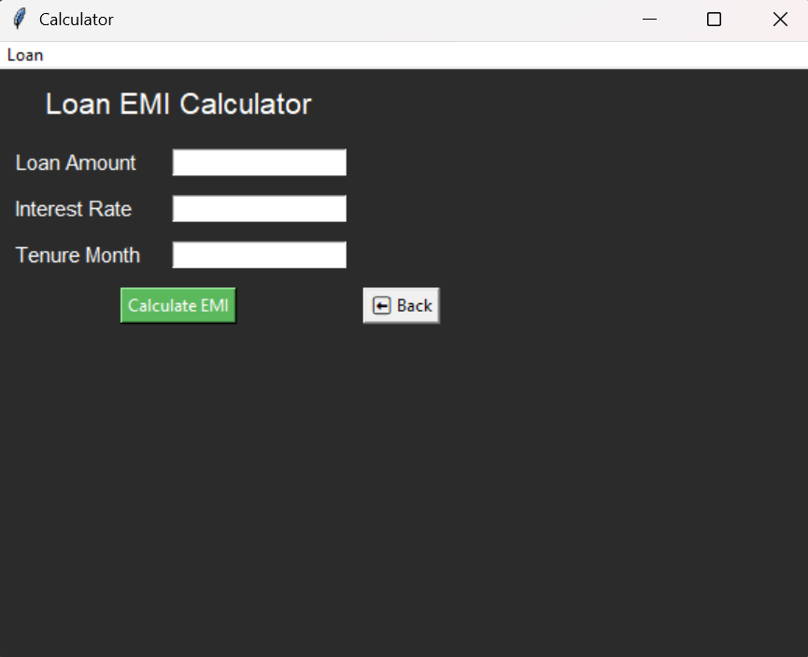
This screen displays the Loan EMI
Calculator interface, designed to help users
quickly calculate their monthly loan installments.
Users can enter the following details:
Loan Amount – Total amount borrowed
Interest Rate – Annual rate of interest
Tenure (Months) – Duration of the loan
The “Calculate EMI” button computes the
monthly installment based on the entered values.
The “Back” button allows users to return to the
main calculator screen.
The interface uses a clean and simple layout,
making it easy for users to input data and view
results efficiently.

Slide 6
Thank You

